Slide 1


DR@W Forum 16 Jan 2020
The impassable gap between
experienced and described values
Stefano Palminteri
Human Reinforcement Learning team
Laboratoire de Neurosciences Cognitives et Computationnelles (LNC2)
Institut National de la Santé et de la Recherche Médicale (INSERM)
École Normale Supérieure (ENS)
stefano.palminteri@ens.fr
https://lnc2.dec.ens.fr/en/human-reinforcement-learning

Slide 2
DR@W Forum 16 Jan 2020
The almost impassable gap between
experienced and described values
Stefano Palminteri
Human Reinforcement Learning team
Laboratoire de Neurosciences Cognitives et Computationnelles (LNC2)
Institut National de la Santé et de la Recherche Médicale (INSERM)
École Normale Supérieure (ENS)
stefano.palminteri@ens.fr
https://lnc2.dec.ens.fr/en/human-reinforcement-learning

Slide 3
Outline
Introduction
Study 1 (Garcia et al.)
The ‘impassable gap’ finding (Exp 1)
Controlling for insufficient learning (Exp 2,3)
Controlling for forgetting and jnsufficient training (Expe 4,5)
Controlling for known decision-biases (Exp 1:6)
Controlling for insufficient incentive (Exp 7)
Conclusions
A case for a heuristic (Exp 1:7)
Different value representations (Study 2; Cerrotti et al.)
Perspectives

Slide 4
Outline
Introduction
Study 1 (Garcia et al.)
The ‘impassable gap’ finding (Exp 1)
Controlling for insufficient learning (Exp 2,3)
Controlling for forgetting and insufficient training (Expe 4,5)
Controlling for known decision-biases (Exp 1:6)
Controlling for insufficient incentive (Exp 7)
Conclusions
A case for a heuristic (Exp 1:7)
Different value representations (Study 2; Cerrotti et al.)
Perspectives

Slide 5

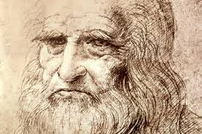

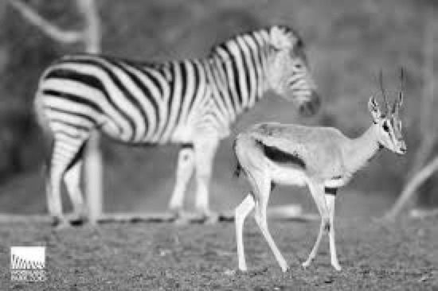

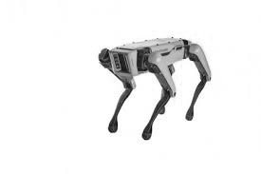
Background: reinforcement learning
A translational cognitive process
What is reinforcement learning
Learning what to do to maximize the future expect return (discounted com of cumulated reward) from repeater interactions with the environment
Goal-directed
Interactional
H. Sapiens
D. Melanogaster
A pervasive cognitive process
Motor skill learning
Foraging decisions
Markov Decision Process
States (s₁,…s_{j})
Actions (a₁,…a_{i})
Reward function R(s₁,…s_{i} , a₁,…a_{i})
Reward r_{t}
With important applications
Psychiatric diseases
AI
Notes:
<numéro>

Slide 6
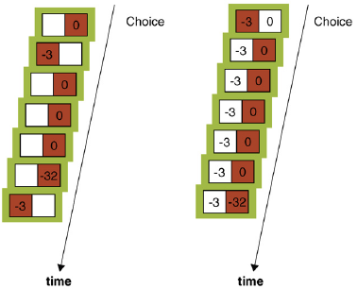
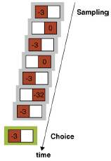
Background: the basic paradigms
Situations with sampling and choice ‘collapsed’
Sampling
(from Erew & Hertwig, TICS, 2009)

Slide 7
Background: the baseline behavioural model
Teaching signal
Action values
Choice Probabilities
PE(s_{j},a₁)
Update (α)
Q(s_{j},a_{i})
Selection (β)
P(s_{j},a_{i})
Agent
Rewards /Punishments R(s_{j},a₁)
Action (a₁)
Environment
Update: delta rule
Q(s,a₁)_{t+1}←Q(s_{j},a₁)_{t}+α(r_{t}-Q(s_{j},a₁)_{t})
Selection: softmax:
P(s_{j},a₁)_{t}→1/(1+exp((Q(s_{j},a₂)_{t}-Q(s_{j},a₁)_{t})/β))

Slide 8
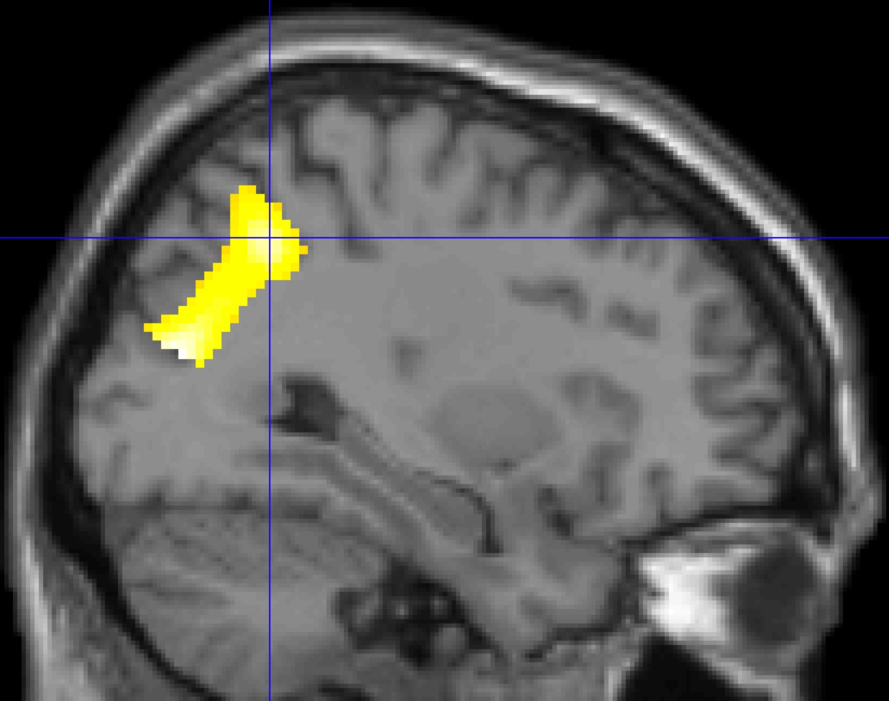
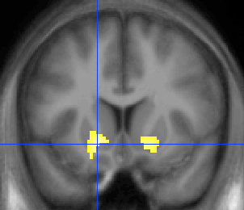
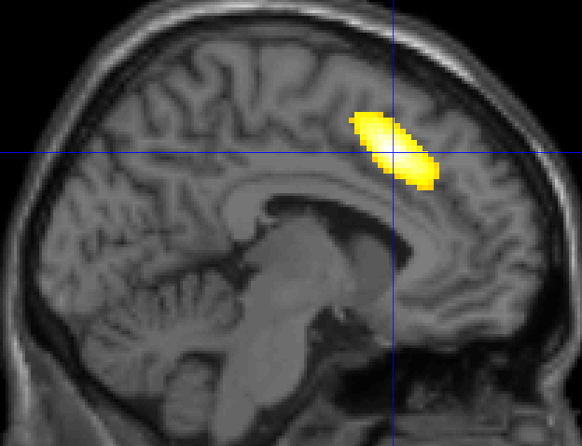
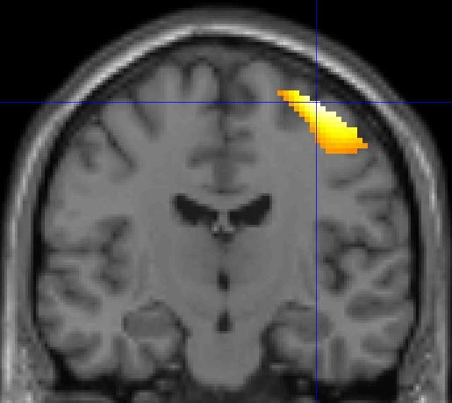
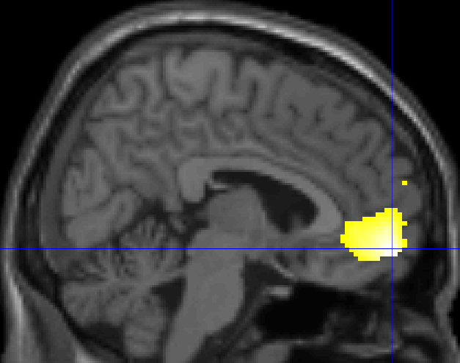
Background: the consensual neural model
Value-independent outcome processing
Value-related outcome variables
Value-related choice variables
Value-independent choice processing
Visual, parietal cortices
Ventral striatum
Primary motor cortex
Prefrontal cortex
Correlates shared by other value-based decision-making modalities
Palminteri et al., Nature C, 2015

Slide 9
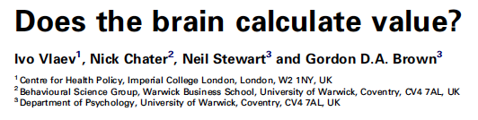
Background: what have I been up to these recent years?
Update: delta rule
Q(s,a₁)_{t+1}←Q(s_{j},a₁)_{t}+α*(r_{t}-Q(s_{j},a₁)_{t})
Do we learn at the same rate from different kind of outcomes? Not really
Lefebvre et al., Nature HB, 2017 (positivity bias)
Palminteri et al., Plos CB, 2017 (confirmation bias)
Do we represent outcomes in an absolute or relative scale?
In between
Palminteri et al., Nature C, 2015 (reference point)
Bavard et al., Nature C, 2018 (range)

Slide 10




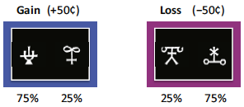
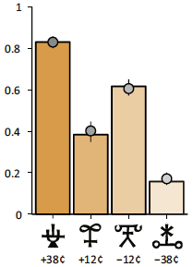
Background: the original research question
Learning > Transfer paradigm to infer how values are learnt
Choice context AB
Choice context AC
Choice context CD
Choice context BD
^
^
^
^
After ~100 trials
with feedback
Learning…
Transfer…
(all possible combinations)

Slide 11

Background: the original research question
Learning > Transfer paradigm to infer how values are learnt
Choice context AB
Choice context AC
Choice context CD
Choice context BD
^
^
^
^
After ~100 trials
with feedback
Experience vs. Description
What about a direct comparison with explicit lotteries (described values)?
^

Slide 12
Outline
Introduction
Study 1 (Garcia et al.)
The ‘impassable gap’ finding (Exp 1)
Controlling for insufficient learning (Exp 2,3)
Controlling for forgetting and insufficient training (Expe 4,5)
Controlling for known decision-biases (Exp 1:6)
Controlling for insufficient incentive (Exp 7)
Conclusions
A case for a heuristic (Exp 1:7)
Different value representations (Study 2; Cerrotti et al.)
Perspectives

Slide 13
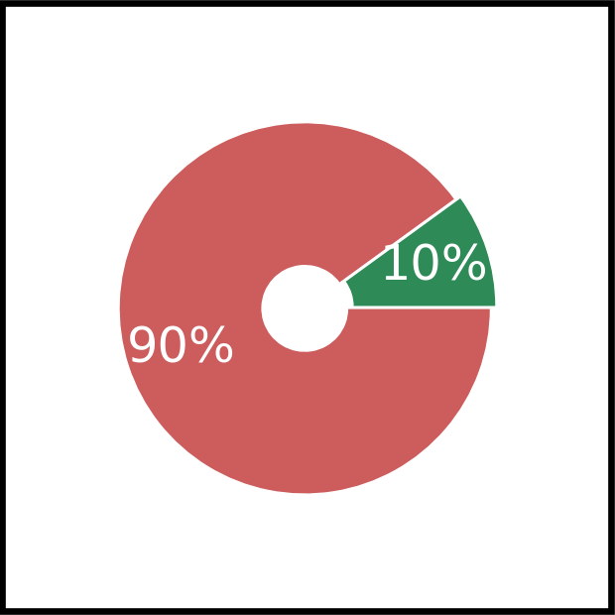

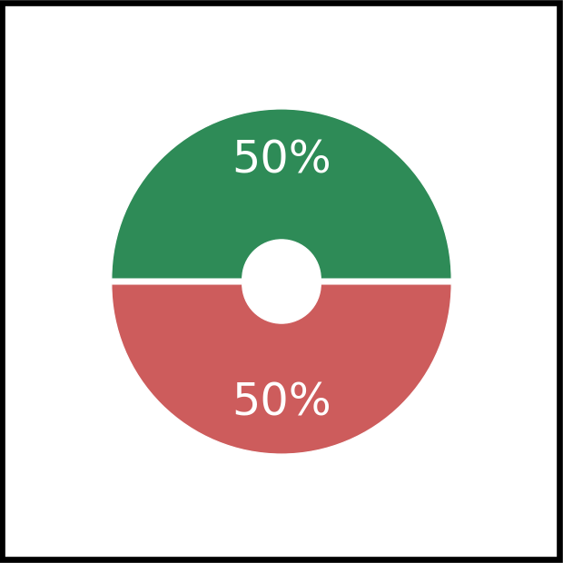





Experimental design
Learning phase
(30x4 trials)
Elicitation phase
(8x11 trials)
8 Catch trials
+1
^
^
^
^
P(winning)
(losing otherwise)
P(winning)
(losing otherwise)
0.9 / 0.1
1.0
0.9
0.8
0.7
0.6
0.5
0.4
0.3
0.2
0.1
0.0
0.8 / 0.2
0.7 / 0.3
0.6 / 0.4

Slide 14
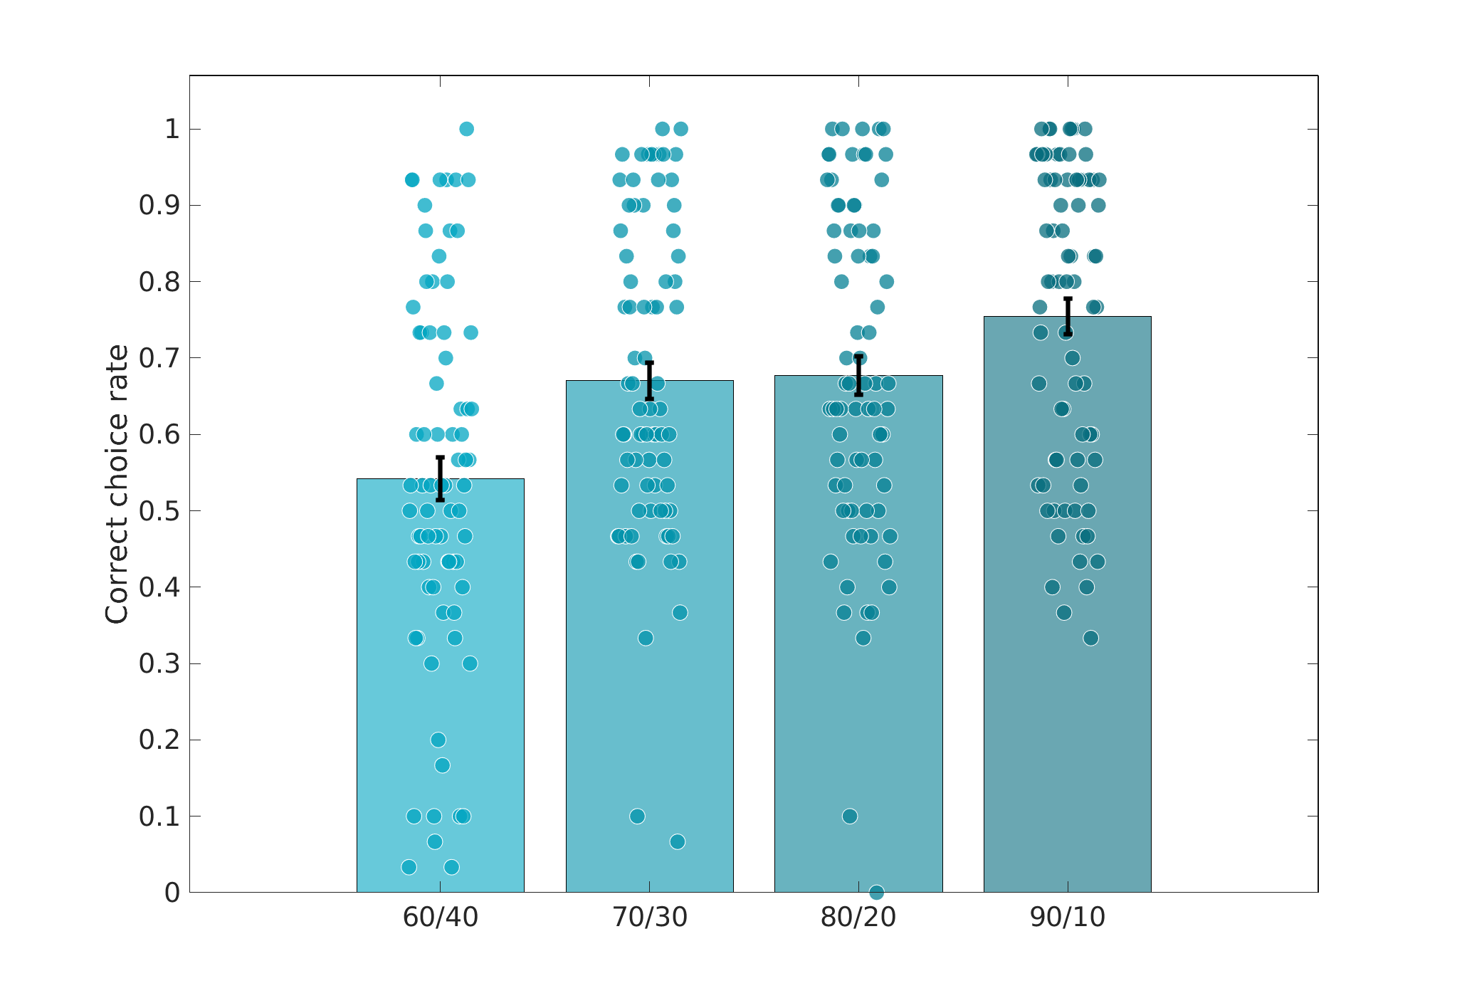
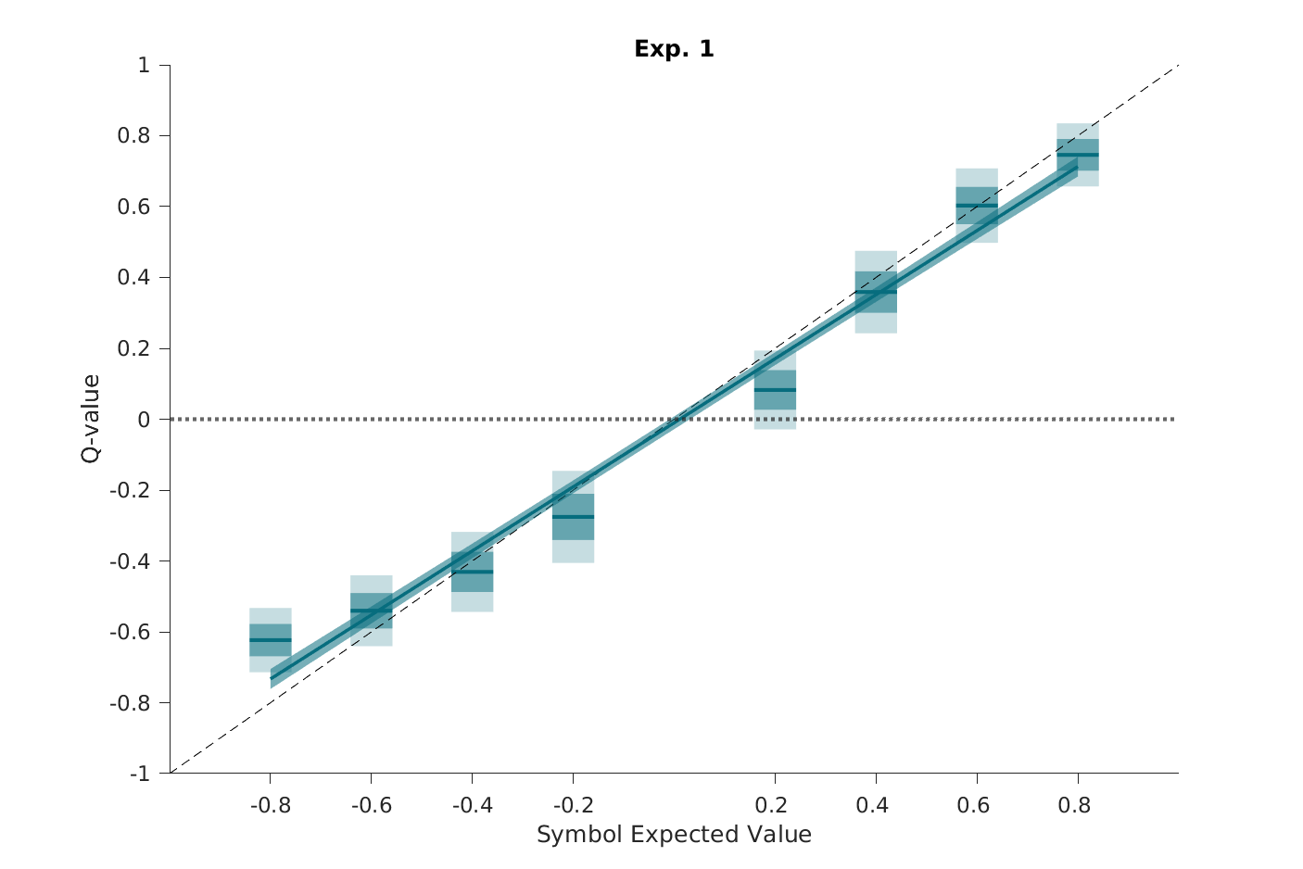
Results: learning phase
Correct response rate
(i.e., EV maximizing)
Inferred Q-values
Q(s,a₁)_{t+1}←Q(s_{j},a₁)_{t}+α(r_{t}-Q(s_{j},a₁)_{t})
P(s_{j},a₁)_{t}→1/(1+exp((Q(s_{j},a₂)_{t}-Q(s_{j},a₁)_{t})))

Slide 15
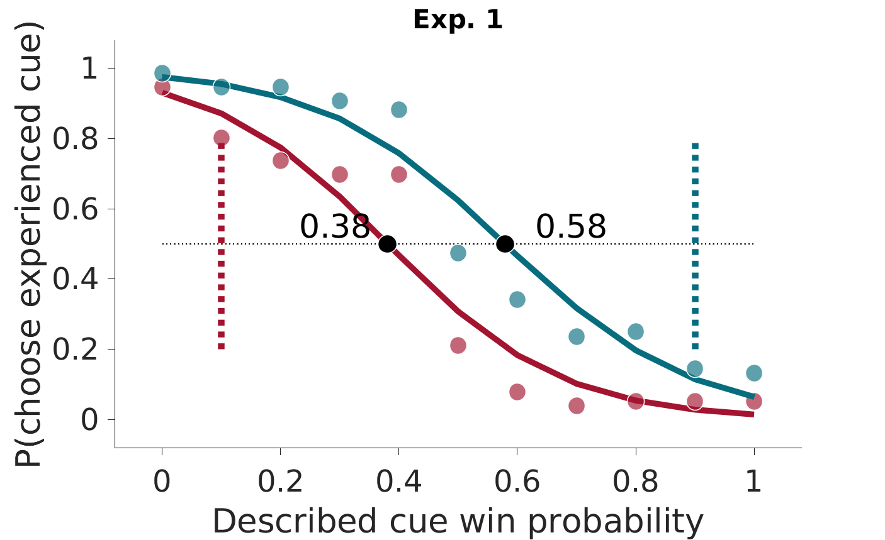
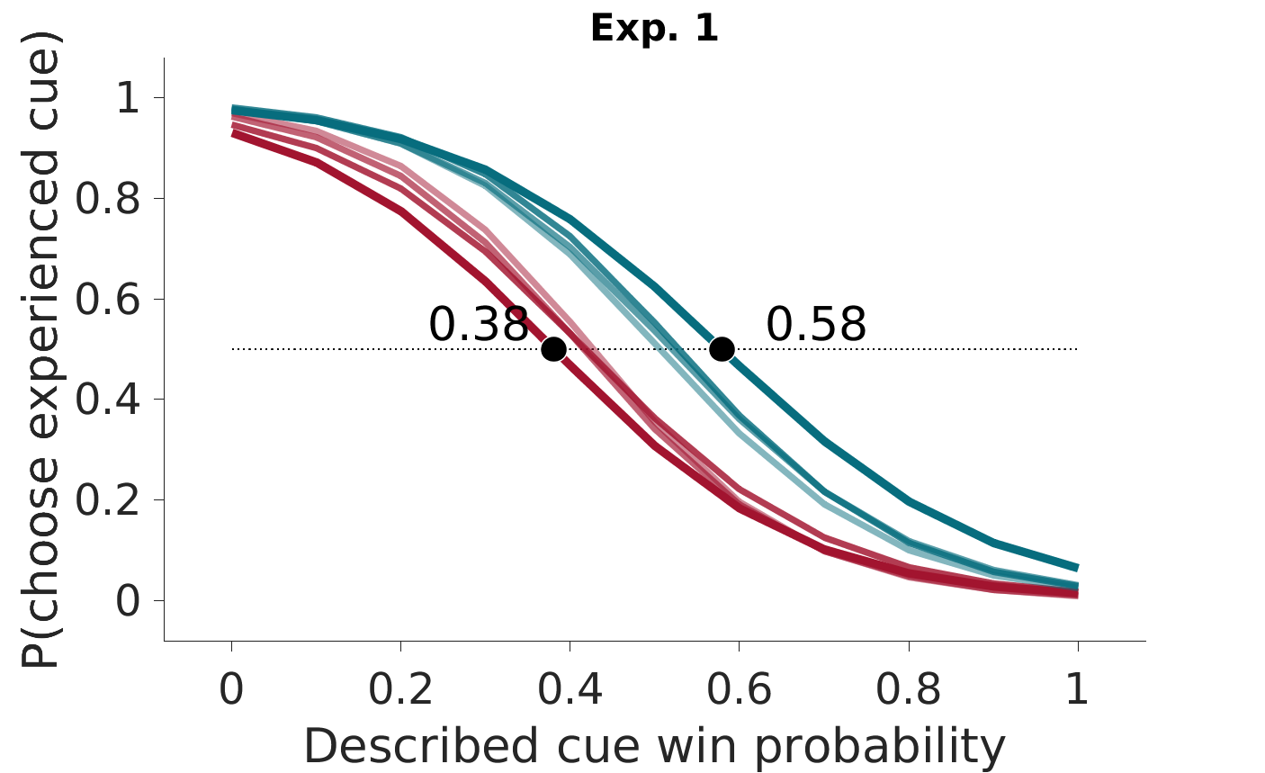
Results: elicitation task
0.9 / 0.1
“Extreme” value options
All options
Choosing
too much the symbol
Choosing
too much the lottery

Slide 16
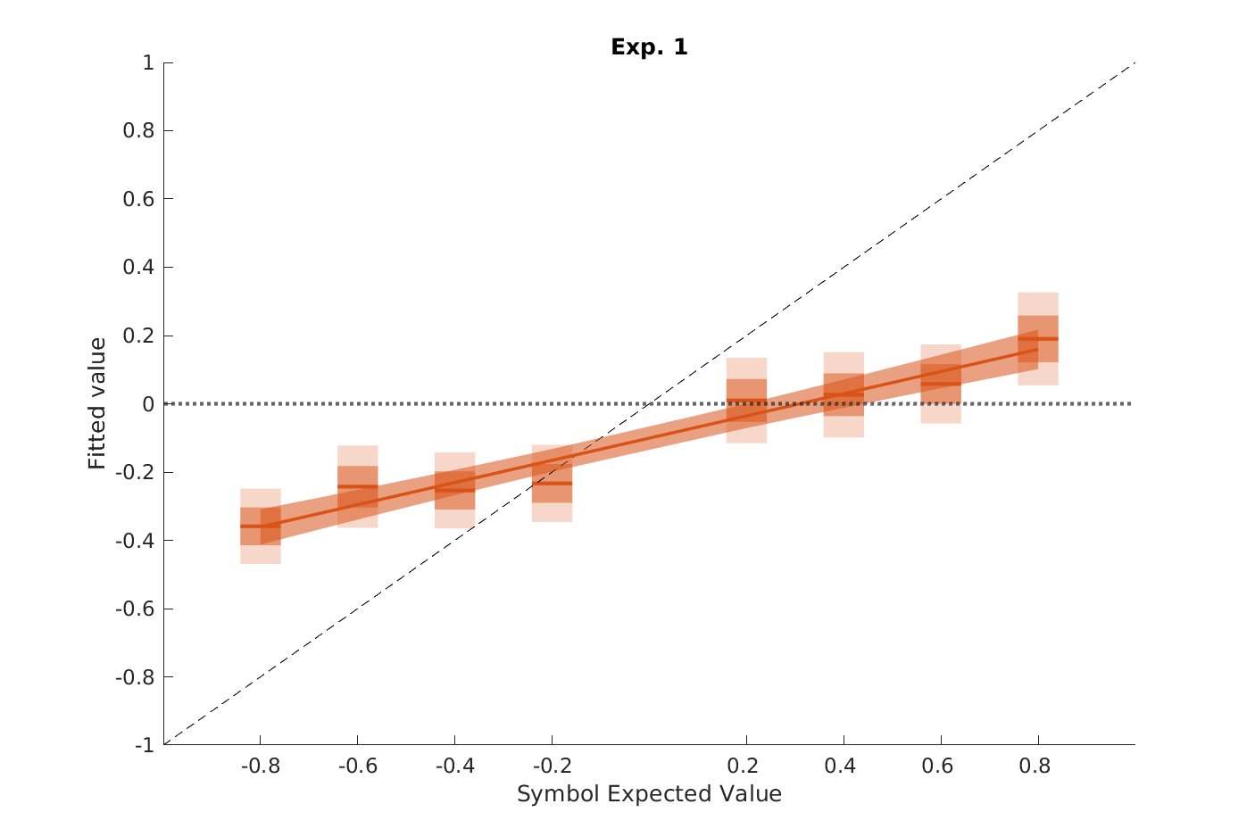
Interim conclusions and criticisms
Participants have trouble comparing values coming from experience and described (the ‘impassable’ gap)
→ Participants follow a better-than-zero heuristic
Inferring values
P(choice)=1/(1+exp((EV(D)-EV(E))))
Criticism:
It is just because learning was not sufficient

Slide 17
Outline
Introduction
Study 1 (Garcia et al.)
The ‘impassable gap’ finding (Exp 1)
Controlling for insufficient learning (Exp 2,3)
Controlling for forgetting and insufficient training (Expe 4,5)
Controlling for known decision-biases (Exp 1:6)
Controlling for insufficient incentive (Exp 7)
Conclusions
A case for a heuristic (Exp 1:7)
Different value representations (Study 2; Cerrotti et al.)
Perspectives

Slide 18


Experimental designs
Experiment 2: Experiment 1 + blocked design
→
(each color represents choice context)
Experiment 3: Experiment 2 + complete feedback
→
^
+1
^
^
+1
^
-1
^

Slide 19
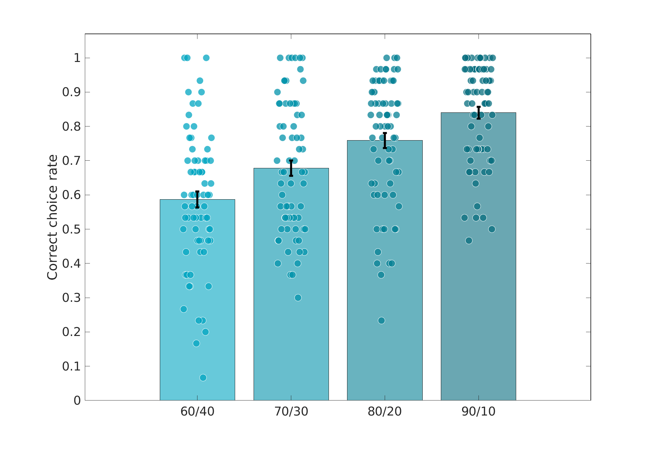
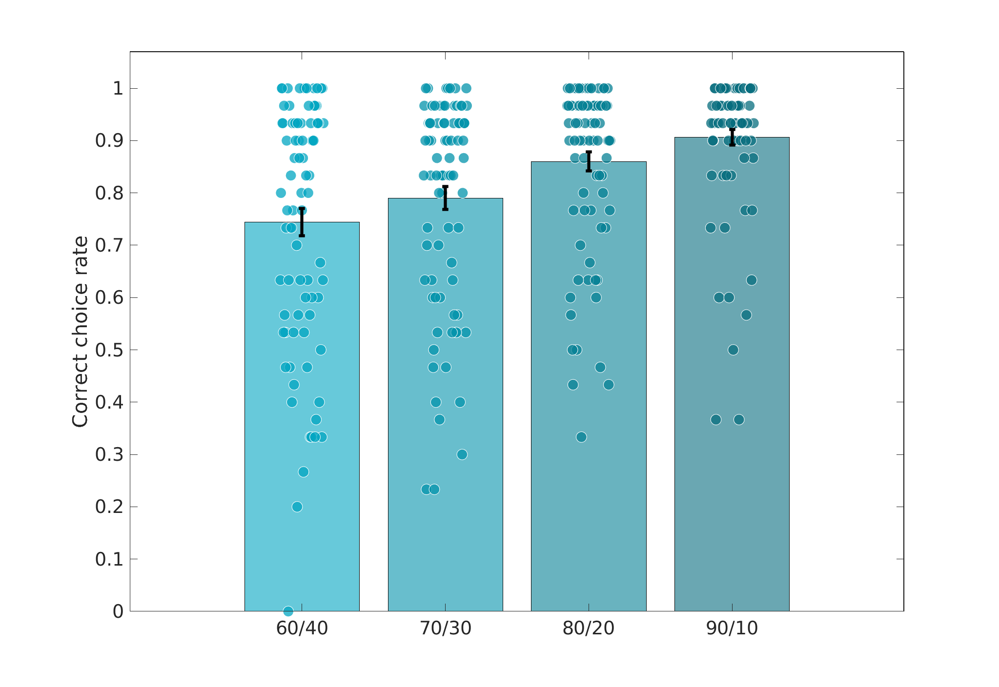
Results: learning phase
Experiment 2
Blocked / Partial
Experiment 3
Blocked / Complete

Slide 20
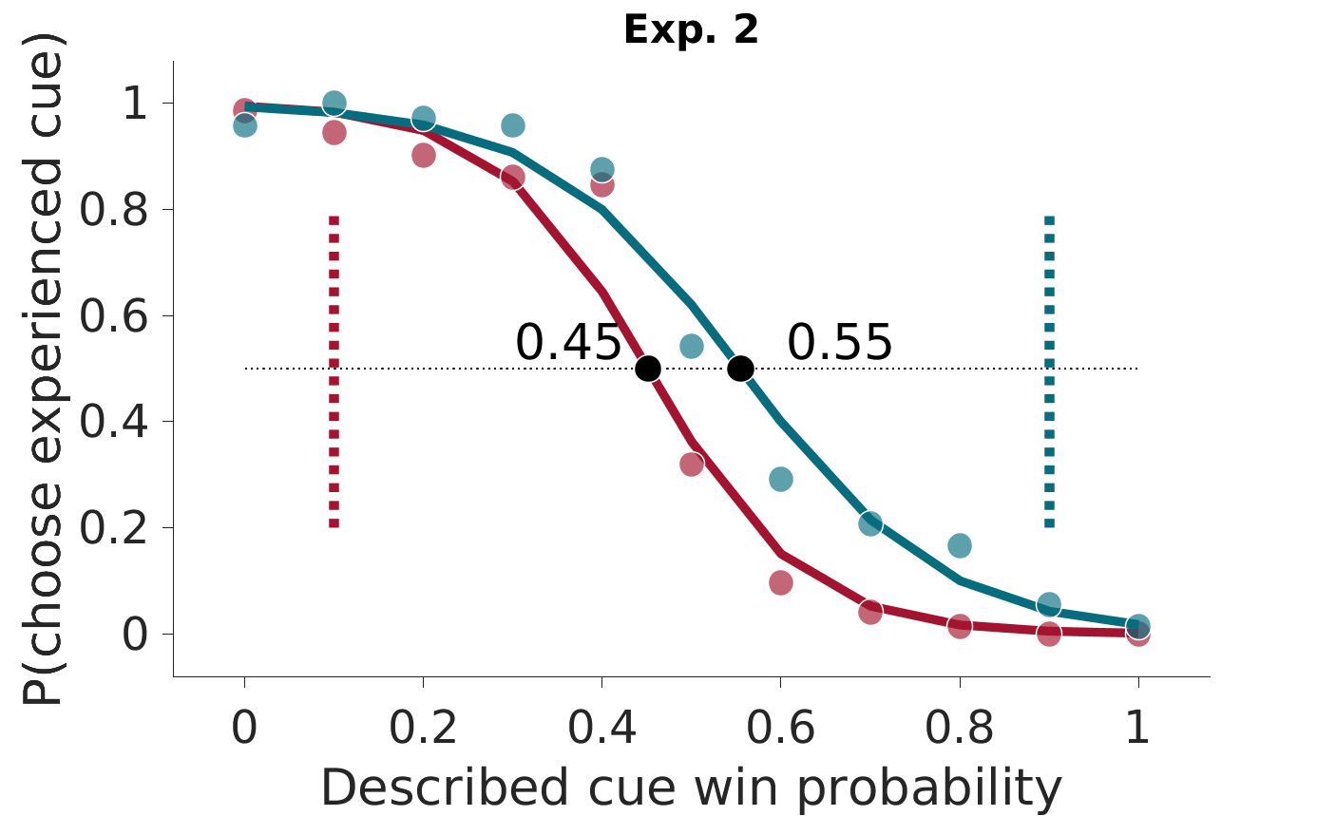
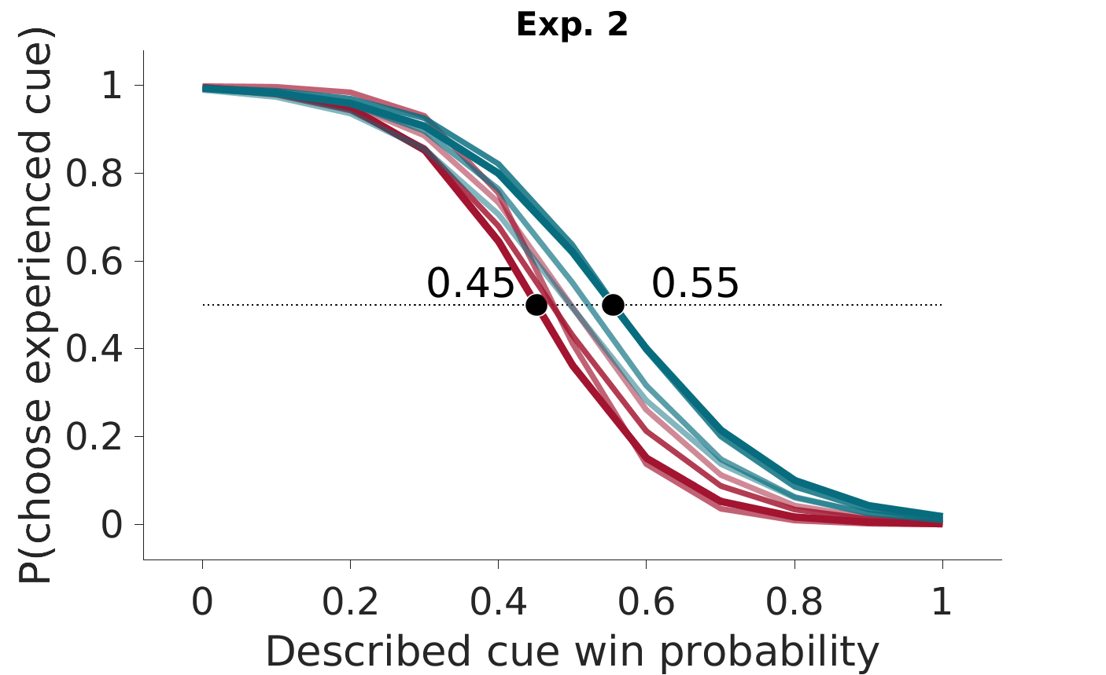
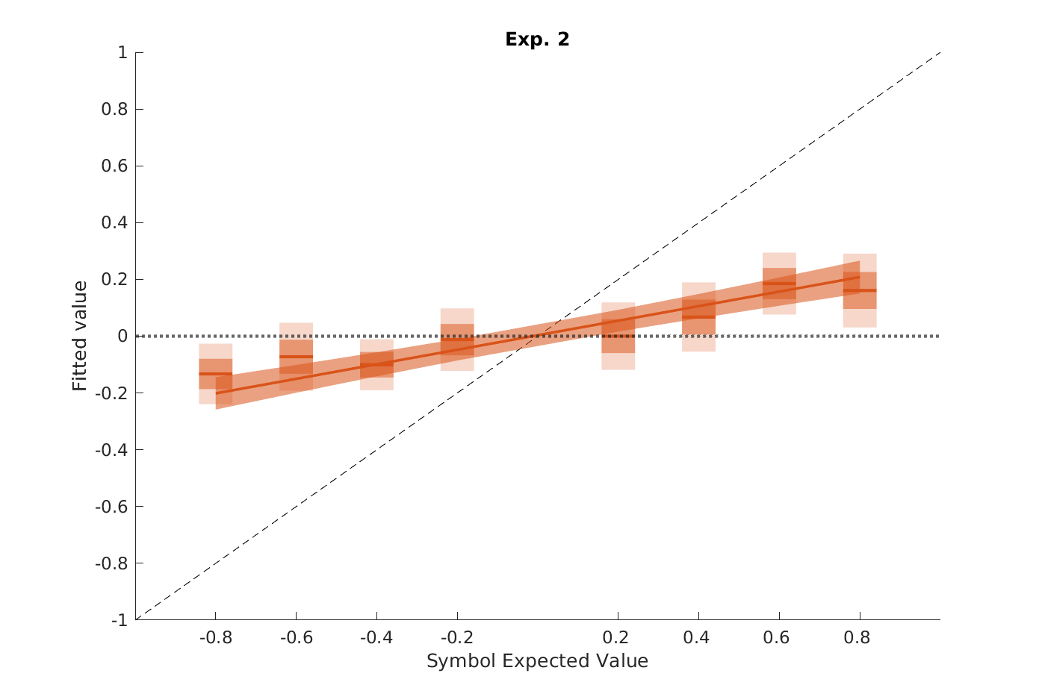
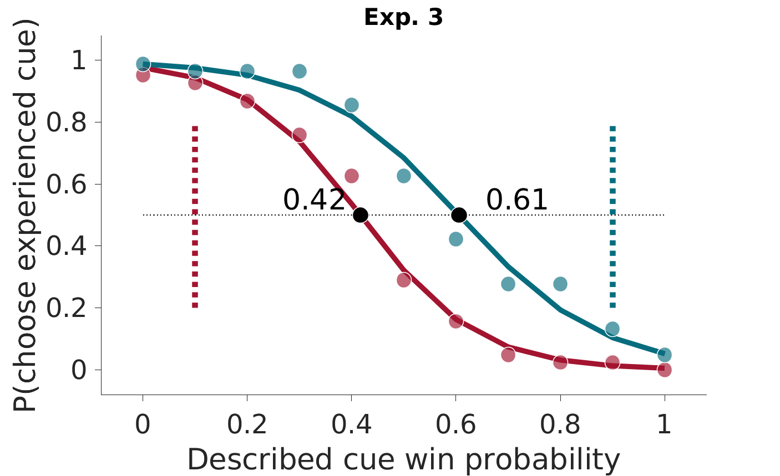
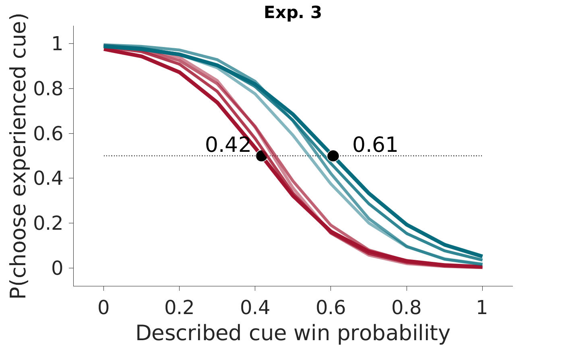
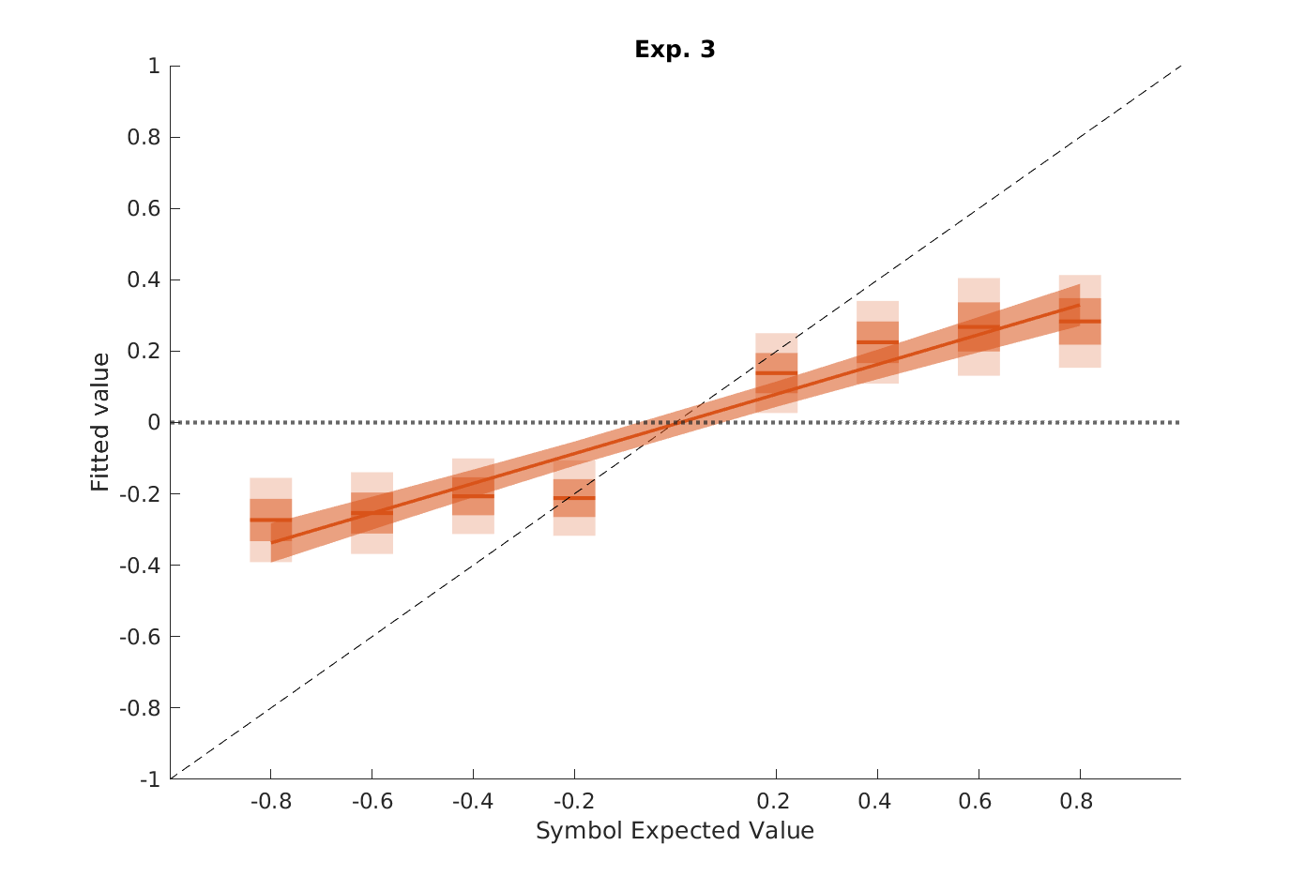
Results: elicitation test
“Extreme” value options
All options
Inferred Values

Slide 21
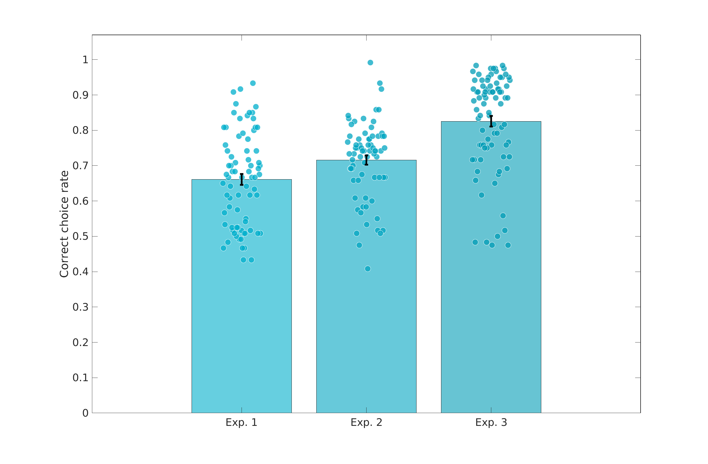
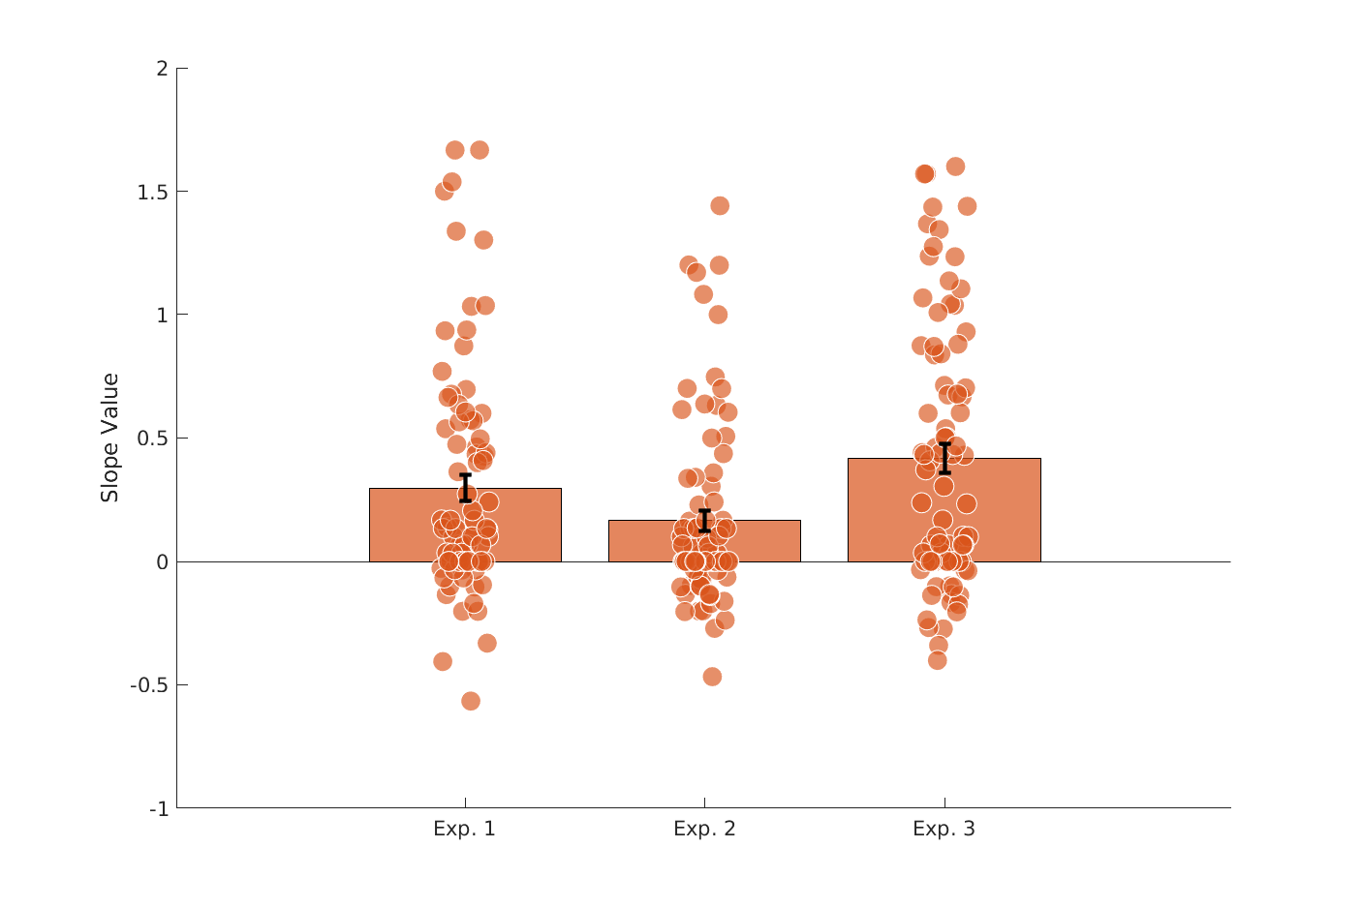
Interim conclusions and criticisms
Improving learning (even quite significantly) does not improve the commensurability of experienced and described values
Correct choice rate
Slope inferred values
E1 / E2 / E3
E1 / E2 / E3
Criticism:
The elicitation tasks occurring after learning, participants may have partially forgot the values (regression to the mean)
Participants did not memorize actively and were surprised by the elicitation task

Slide 22
Outline
Introduction
Study 1 (Garcia et al.)
The ‘impassable gap’ finding (Exp 1)
Controlling for insufficient learning (Exp 2,3)
Controlling for forgetting and insufficient training (Expe 4,5)
Controlling for known decision-biases (Exp 1:6)
Controlling for insufficient incentive (Exp 7)
Conclusions
A case for a heuristic (Exp 1:7)
Different value representations (Study 2; Cerrotti et al.)
Perspectives

Slide 23
Experimental designs
Experiment 4: Experiment 3 + EE choices
Learning phase
+1
^
-1
^
^
^
ED
^
^
EE
Experiment 5: Experiment 4 + 2 session
Learning
Phase S1
Elicitation
Phase S1
Learning
Phase S2
Elicitation
Phase S2

Slide 24
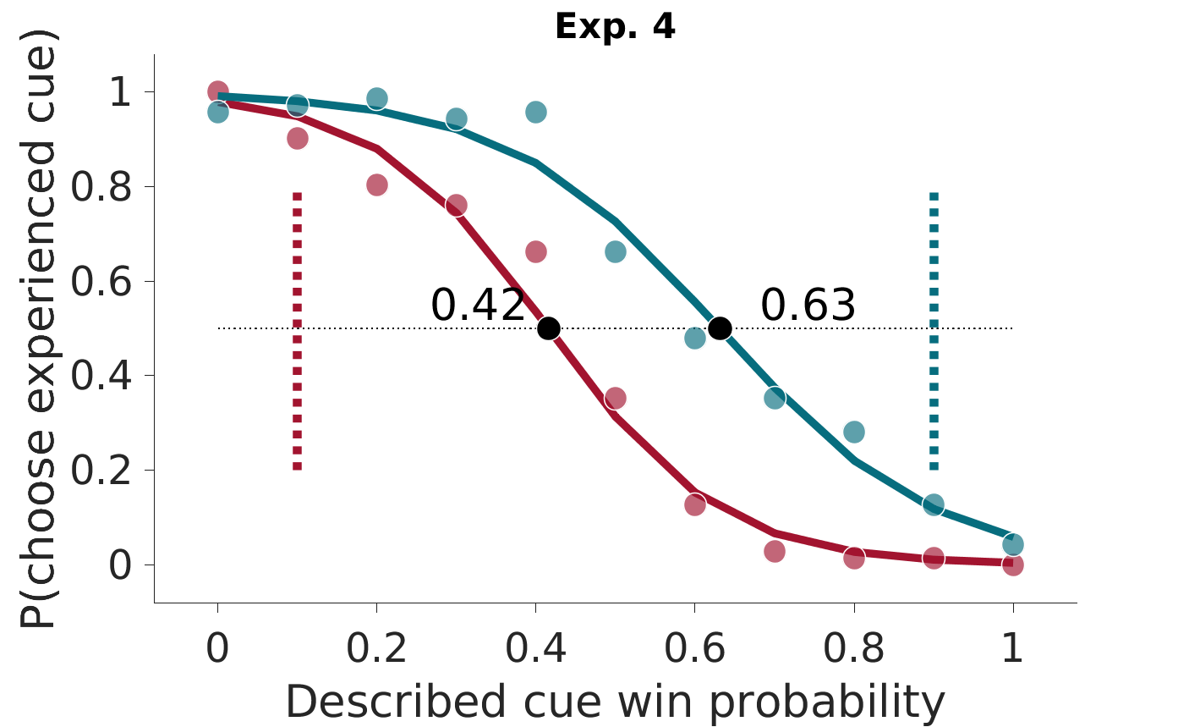
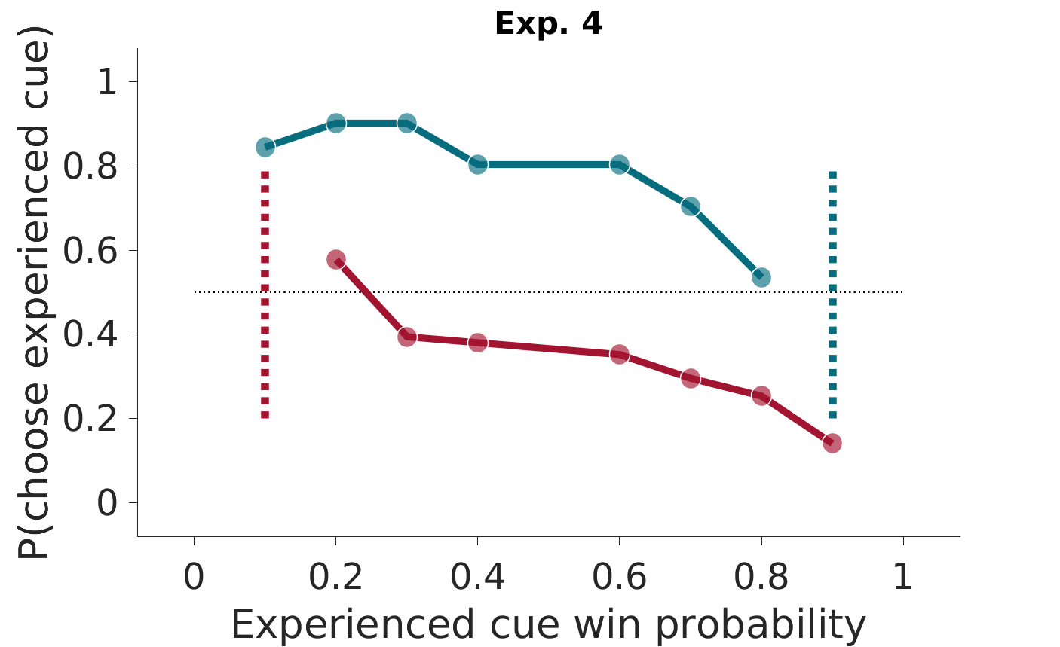
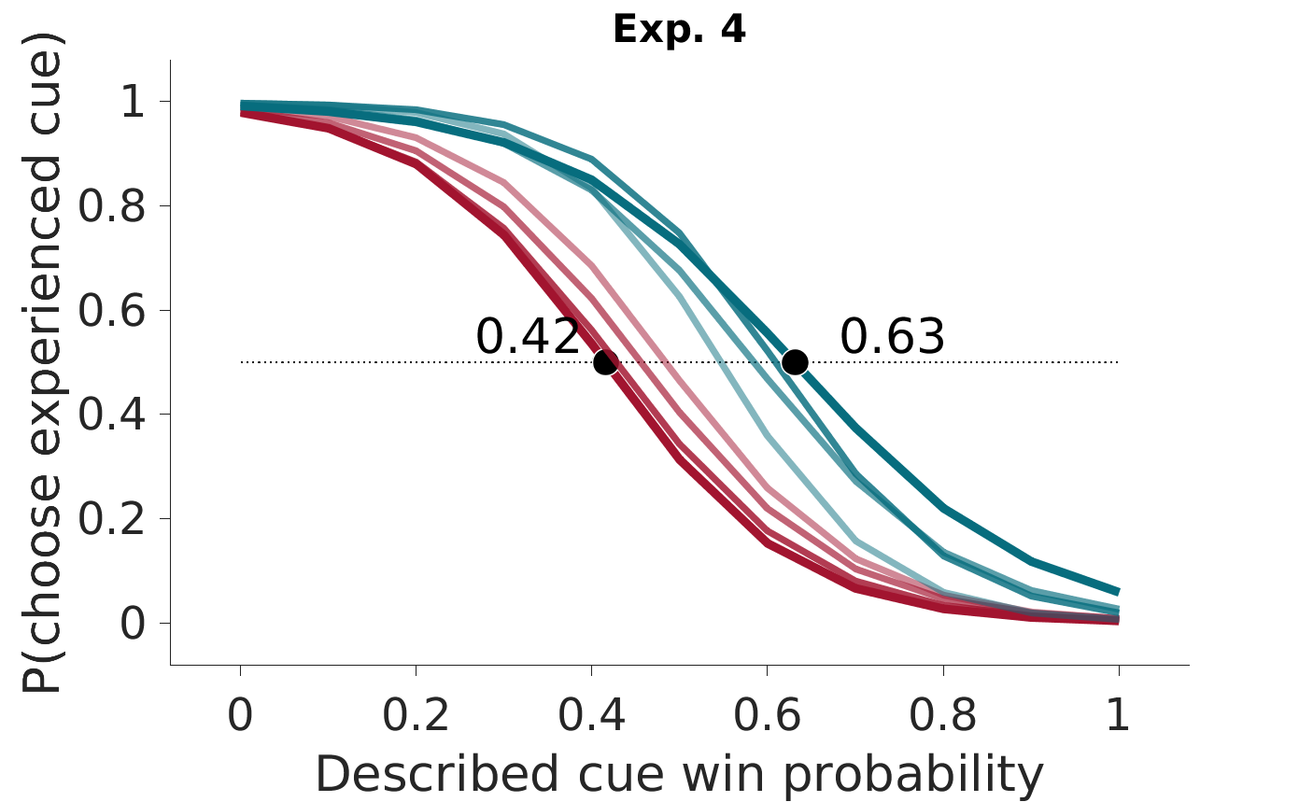
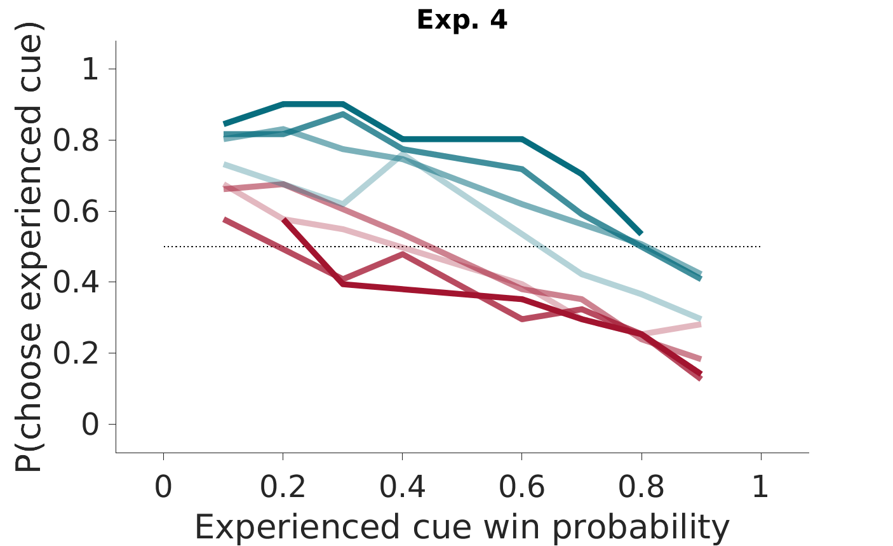
Results: elicitation results (experiment 4)
^
ED
^
EE
“Extreme” value options
“Extreme” value options
All options
All options

Slide 25
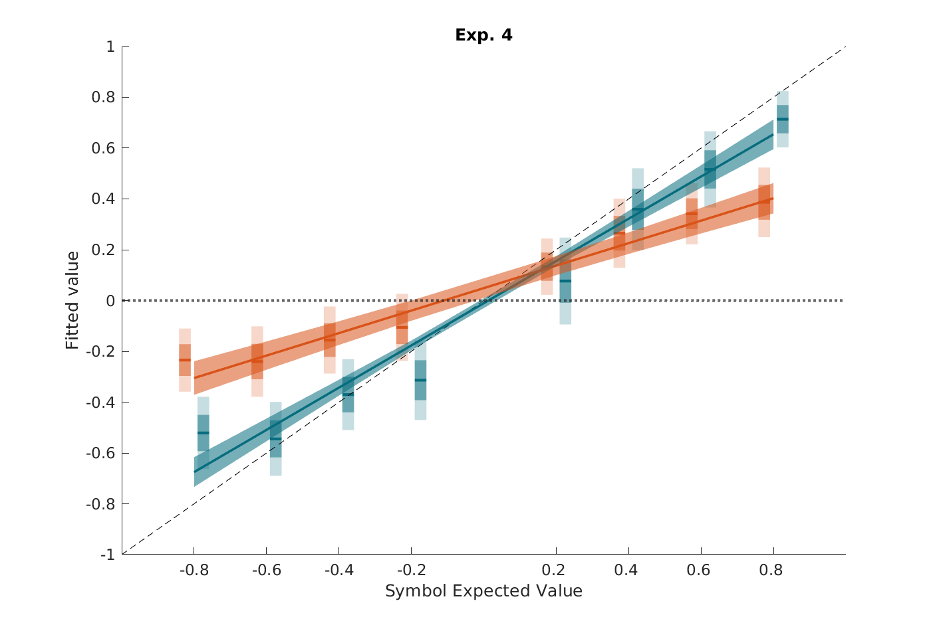
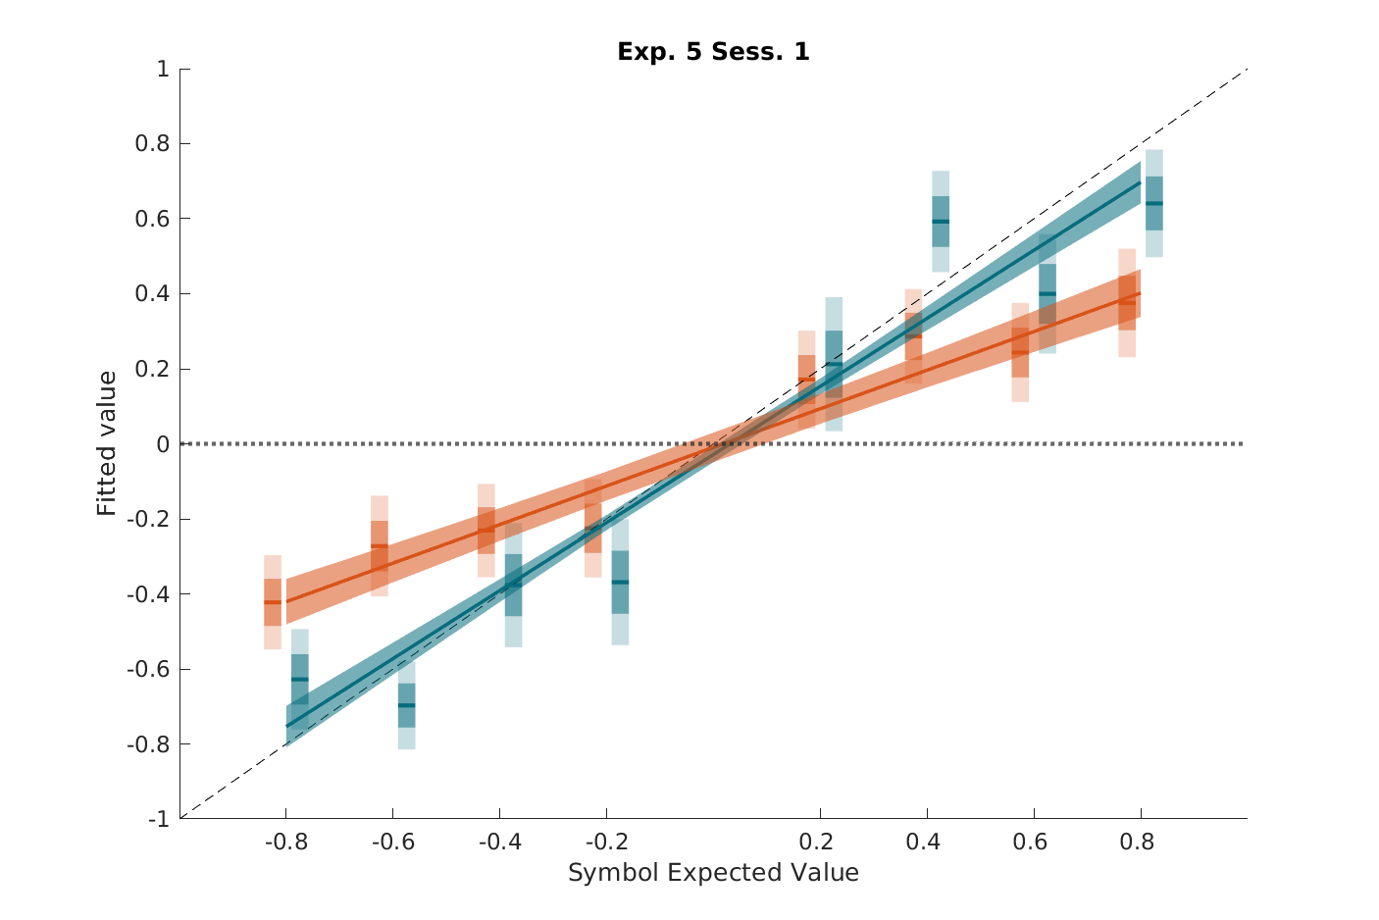
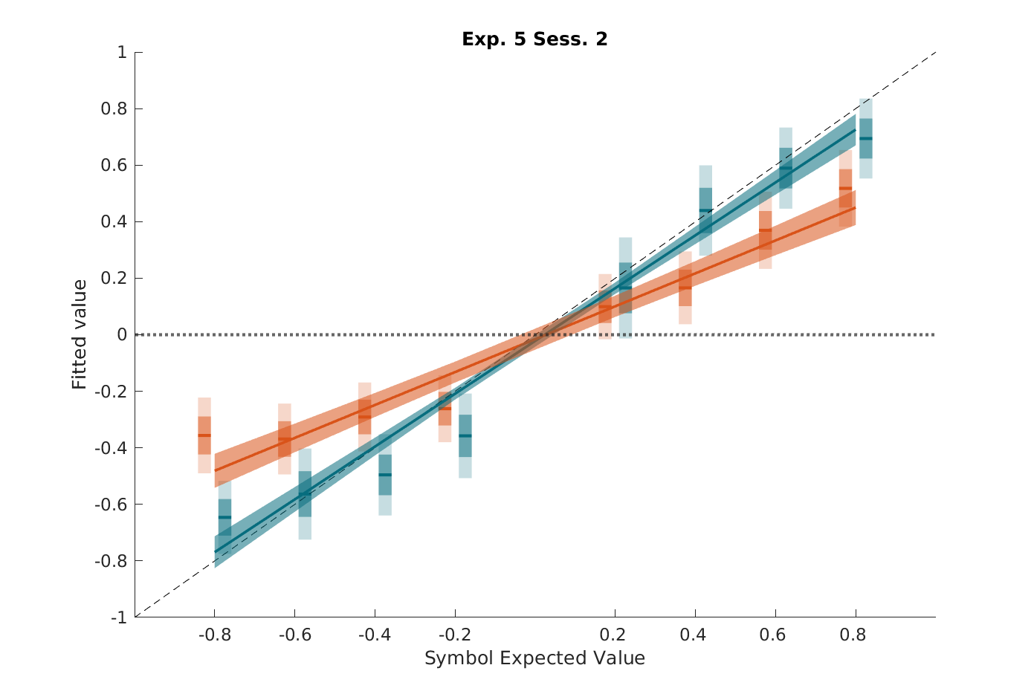
Results: elicitation results (experiment 4 and 5)
Inferred Values
(experiment 4)
Inferred Values
(experiment 5.1)
Inferred Values
(experiment 5.2)
ED
EE
Notes:
<numéro>

Slide 26
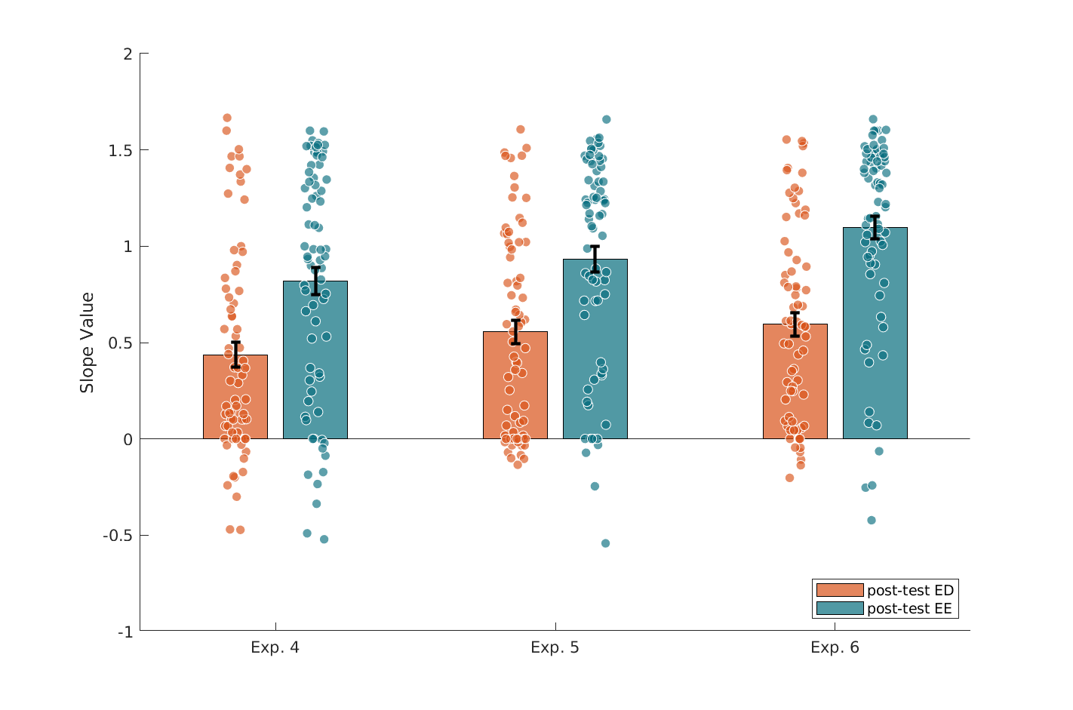
Interim conclusions and criticisms
Assessing values and preferences using Experience -Experience comparisons during the elicitation phase shows that participants still remember the option values (in the experience referential)
Slope inferred values
E4 / E5.1 / E5.2
Criticism:
Can the effect be explained by know decision biases?

Slide 27
Outline
Introduction
Study 1 (Garcia et al.)
The ‘impassable gap’ finding (Exp 1)
Controlling for insufficient learning (Exp 2,3)
Controlling for forgetting and insufficient training (Expe 4,5)
Controlling for known decision-biases (Exp 1:6)
Controlling for insufficient incentive (Exp 7)
Conclusions
A case for a heuristic (Exp 1:7)
Different value representations (Study 2; Cerrotti et al.)
Perspectives

Slide 28
Experimental design
Experiment 6: Experiment 5 + Ambiguity
Learning phase
+1
^
-1
^
^
^
ED
^
?
^
EE
^
?
^

Slide 29
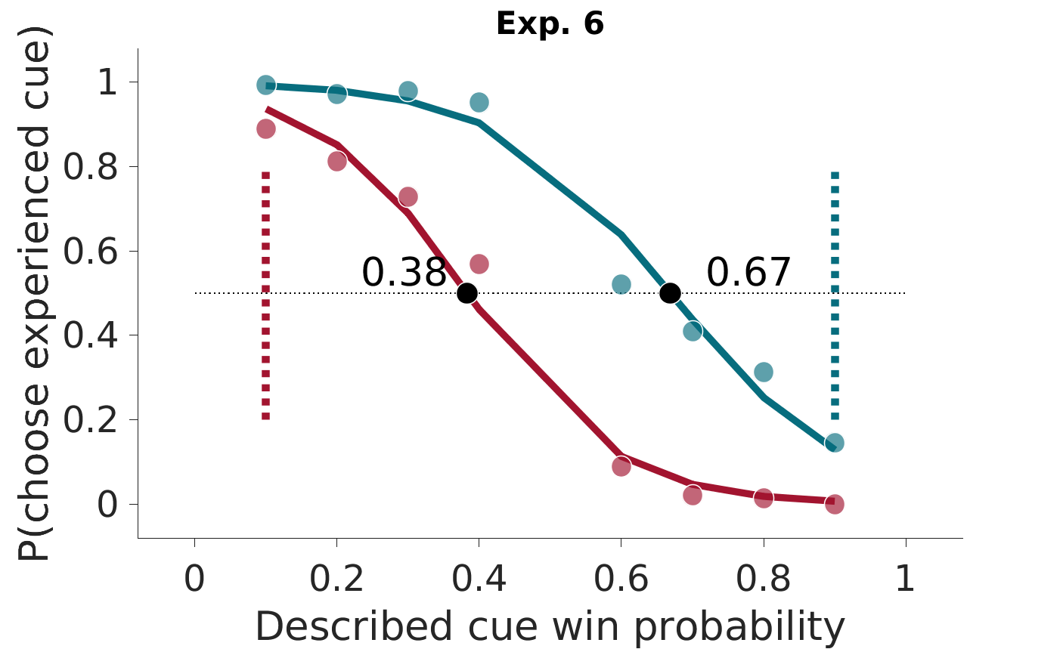
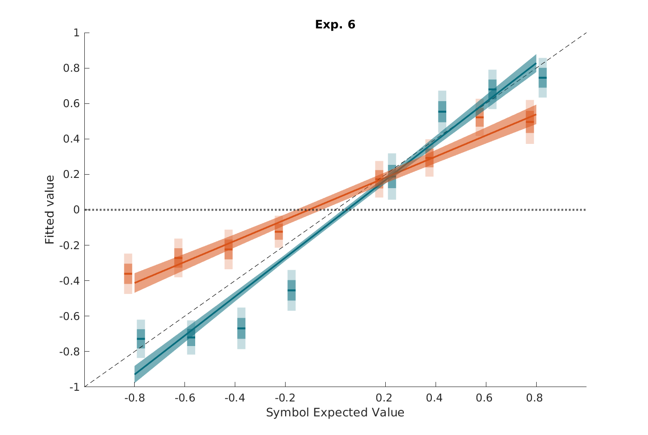
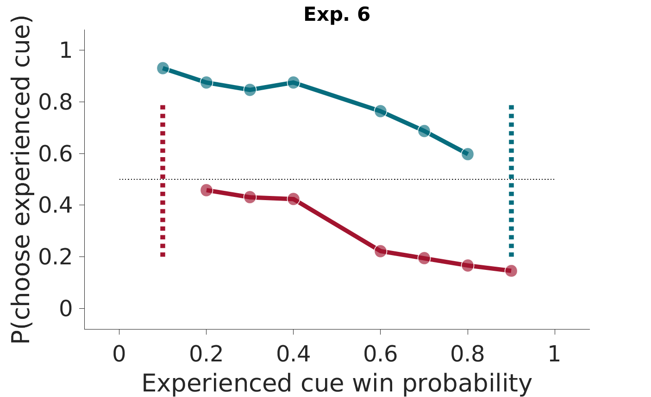
Experimental results: replications
“Extreme” value options (ED)
Inferred values
“Extreme” value options (EE)
ED
EE

Slide 30
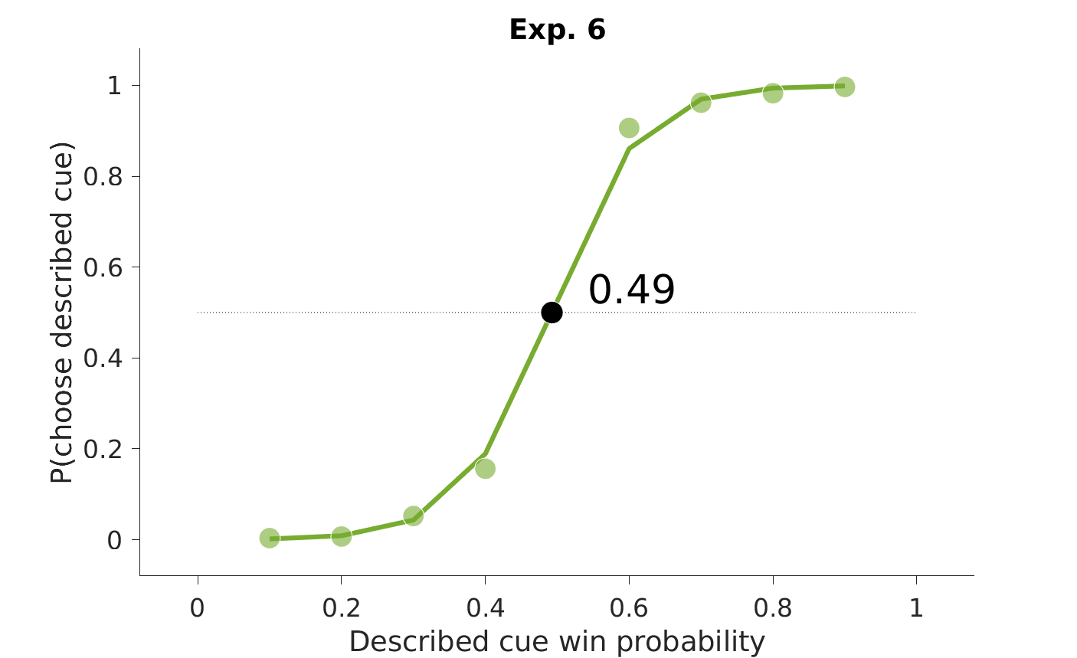
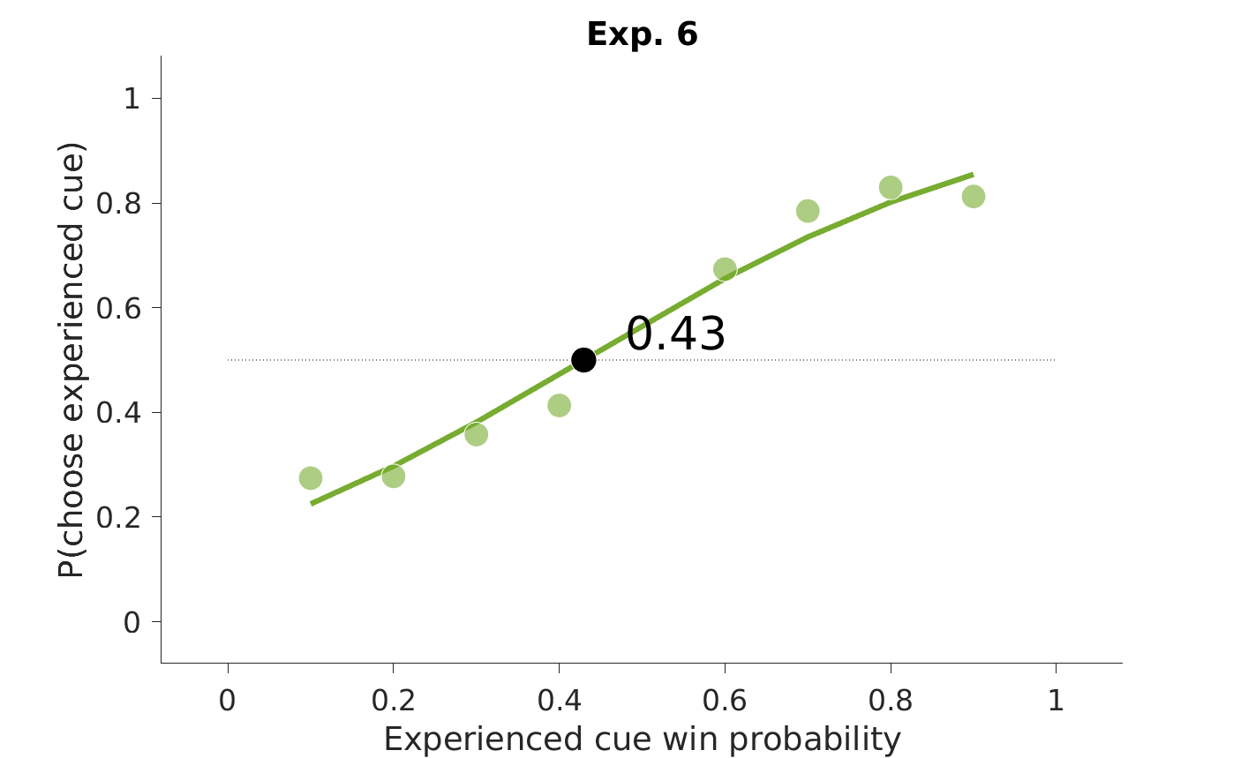
Experimental results: ambiguity
?
?

Slide 31
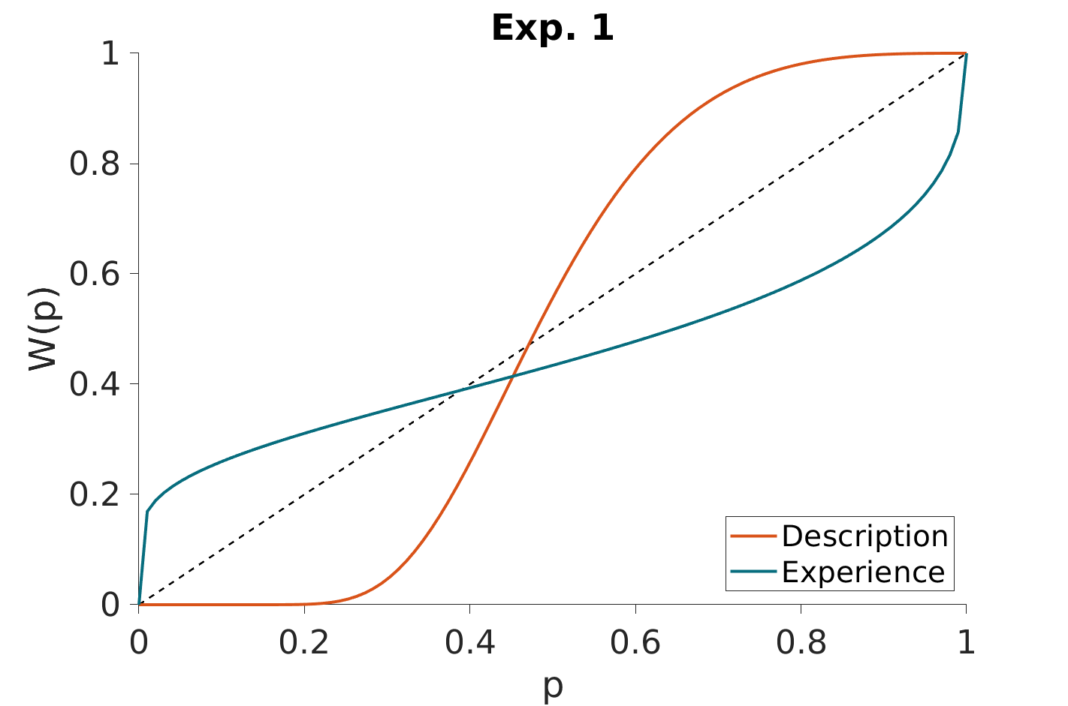
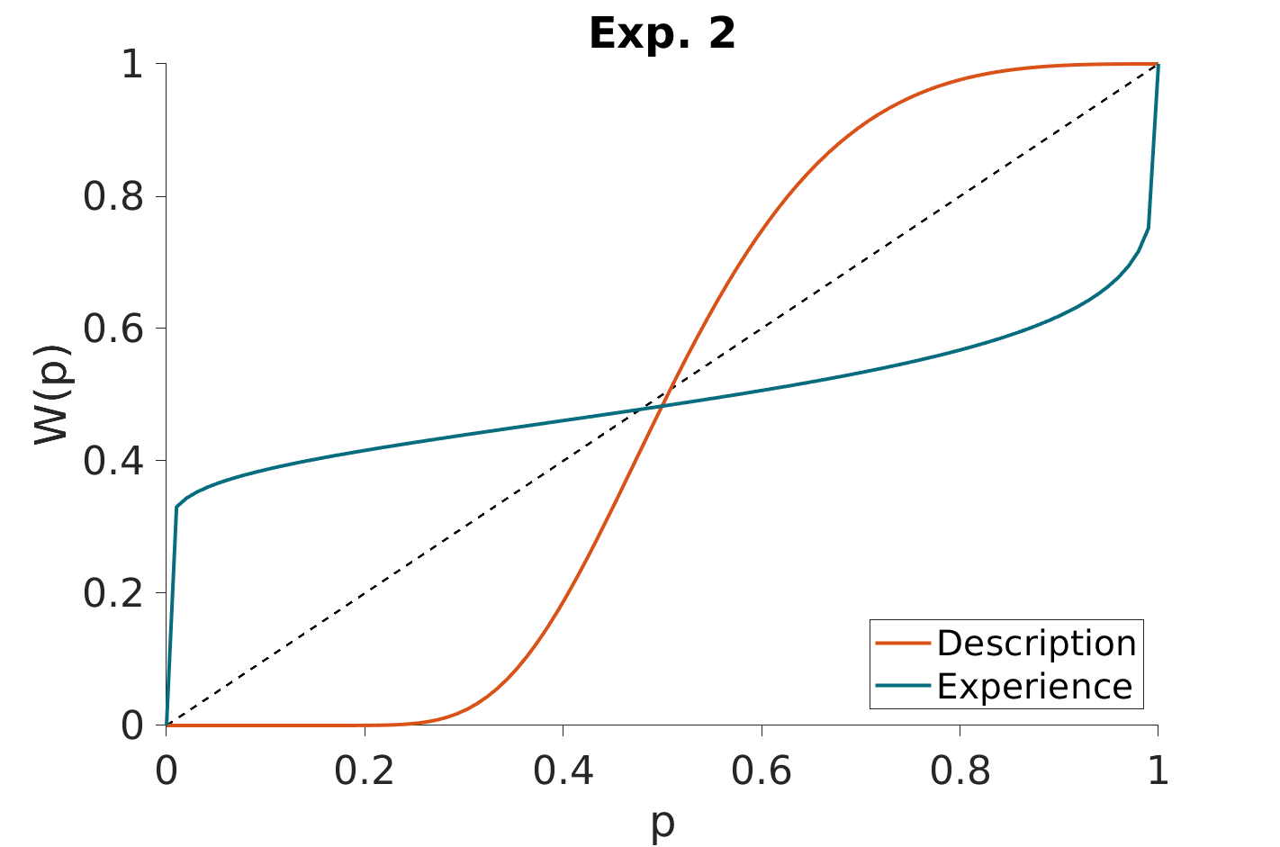
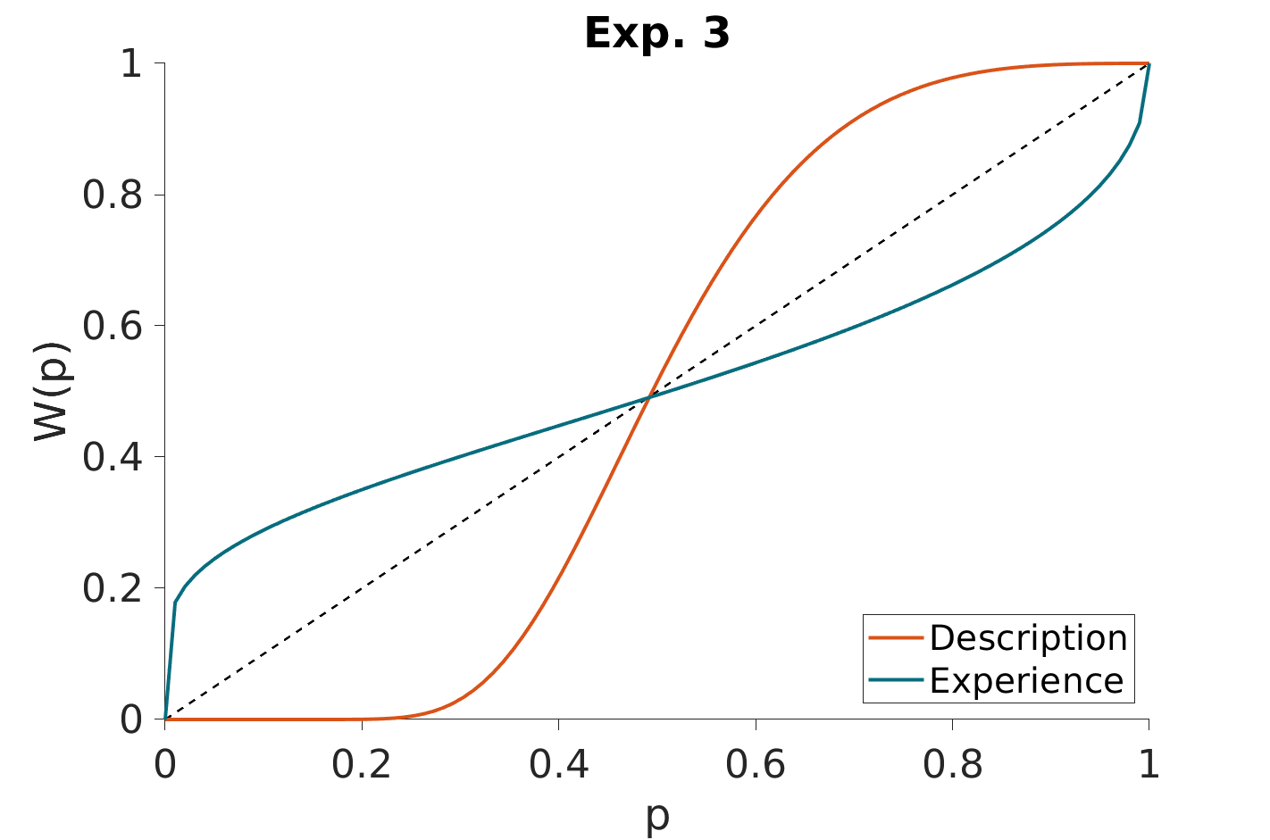
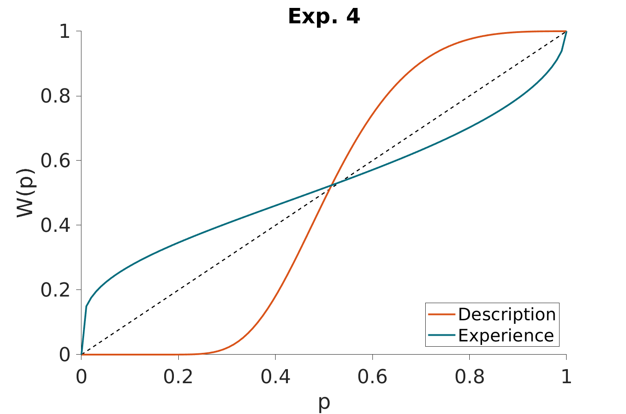
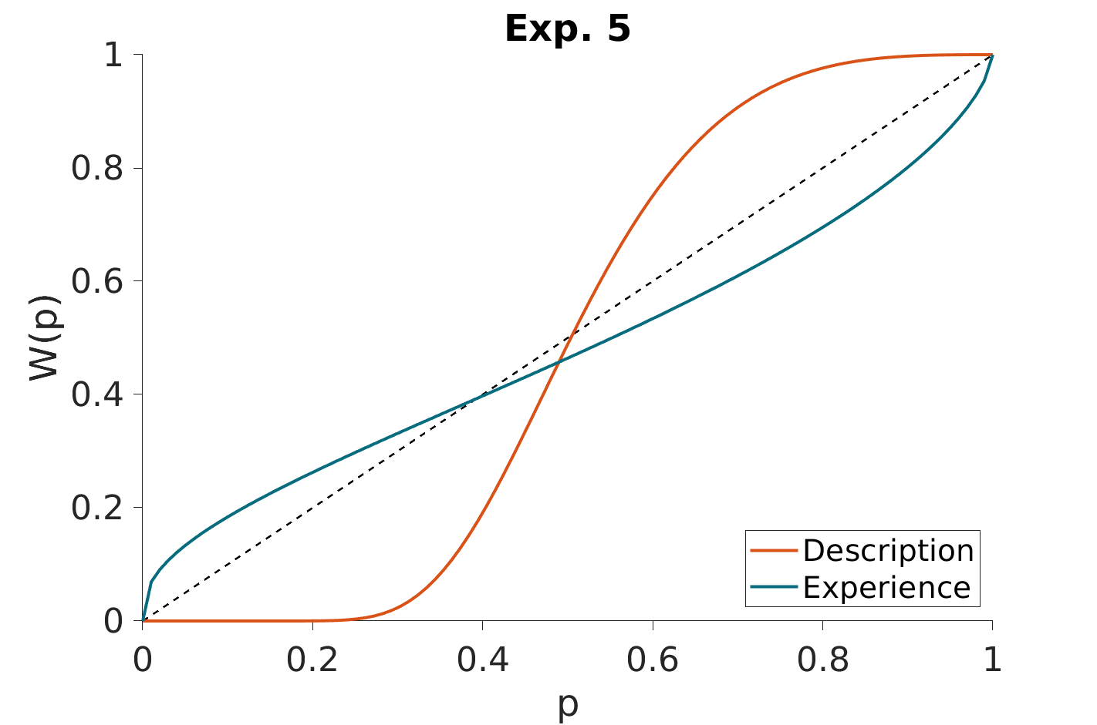
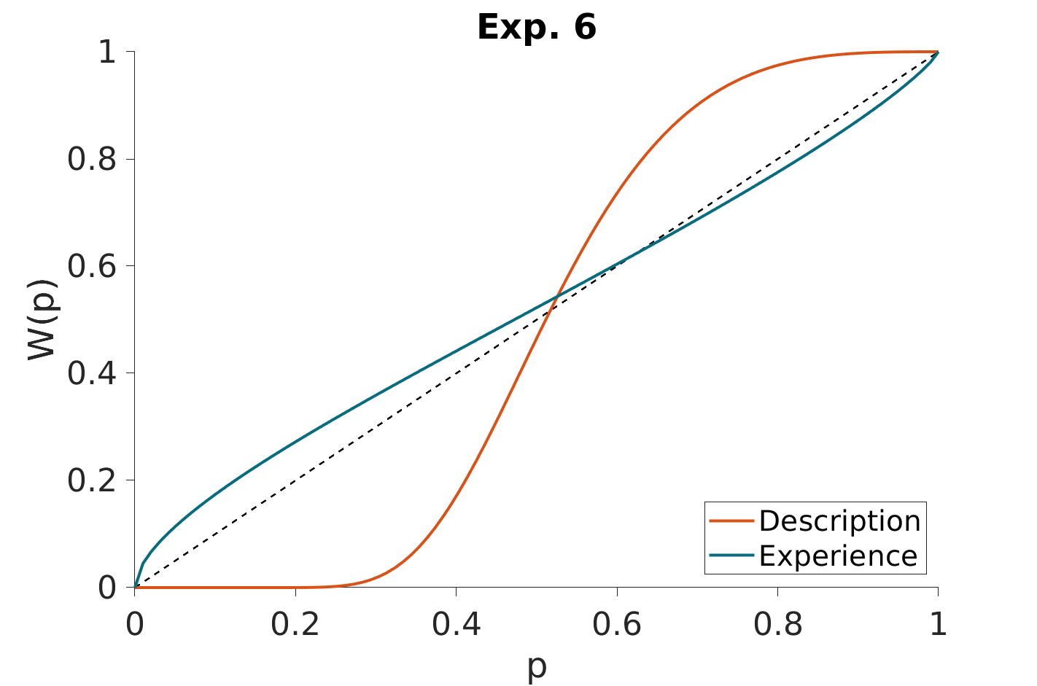
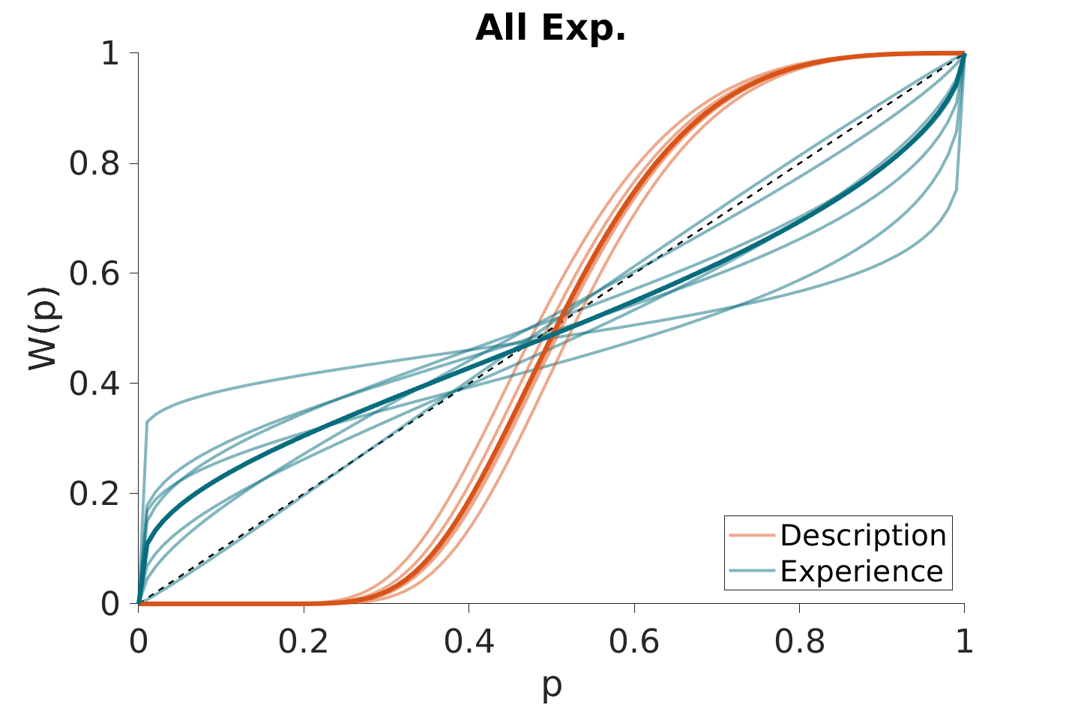
What about probability weighting? (Prelec, Econometrica, 1998)
(Parameters fitted in the ED choices)

Slide 32



Interim conclusions and criticism
Ambiguity aversion and standard probability weighting do not explain the better-than-zero heuristic
Criticism:
Is behaving like that (economically) costly? Actually it is not!

Slide 33
Outline
Introduction
Study 1 (Garcia et al.)
The ‘impassable gap’ finding (Exp 1)
Controlling for insufficient learning (Exp 2,3)
Controlling for forgetting and insufficient training (Expe 4,5)
Controlling for known decision-biases (Exp 1:6)
Controlling for insufficient incentive (Exp 7)
Conclusions
A case for a heuristic (Exp 1:7)
Different value representations (Study 2; Cerrotti et al.)
Perspectives

Slide 34

Experimental design
Experiment 7: Experiment 6 + modified contingencies
P(winning)
(losing otherwise)
→
P(winning)
(losing otherwise)
0.9
0.8
0.7
0.6
0.4
0.2
0.1
0.9
0.8
0.7
0.6
0.4
0.2
0.1
0.9
0.85
0.8
0.75
0.25
0.2
0.15
0.1
0.7
0.65
0.6
0.55
0.45
0.4
0.35
0.30

Slide 35






Experimental results: replications
ED
A-D
Inferred values
EE
A-E
Slope

Slide 36

Experimental results: replications
Correct choice rate in the EE and ED decisions

Slide 37
Interim conclusion and (temporary) claim
Choices in the elicitation task are not strategically changed by the changes in contingencies. The better-than-zero heuristic is maintained also when it is costly.
Why?
Experienced and descried values are not easily commensurable because they involve different representational systems

Slide 38
Outline
Introduction
Study 1 (Garcia et al.)
The ‘impassable gap’ finding (Exp 1)
Controlling for insufficient learning (Exp 2,3)
Controlling for forgetting and insufficient training (Expe 4,5)
Controlling for known decision-biases (Exp 1:6)
Controlling for insufficient incentive (Exp 7)
Conclusions
A case for a heuristic (Exp 1:7)
Different value representations (Study 2; Cerrotti et al.)
Perspectives

Slide 39





Exhibit 1: reaction times
Experienced and descried values are not easily commensurable because they involve different representational systems
→ longer decisions for E-oriented choices in the ED elicitation task
→ longer choices in the EE elicitation task

Slide 40







Exhibit 2: cognitive reflection test
Experienced and descried values are not easily commensurable because they involve different representational systems
→ the capacity to compare E and D should correlated with the propensity to engage in “System 2”

Slide 41
Outline
Introduction
Study 1 (Garcia et al.)
The ‘impassable gap’ finding (Exp 1)
Controlling for insufficient learning (Exp 2,3)
Controlling for forgetting and insufficient training (Expe 4,5)
Controlling for known decision-biases (Exp 1:6)
Controlling for insufficient incentive (Exp 7)
Conclusions
A case for a heuristic (Exp 1:7)
Different value representations (Study 2; Cerrotti et al.)
Perspectives

Slide 42

Exhibit 3: neural activations
Experienced and descried values are not easily commensurable because they involve different representational systems
→ different neural systems should be involved.

Slide 43

Exhibit 3: neural activations
Experienced and descried values are not easily commensurable because they involve different representational systems
→ different neural systems should be involved.

Slide 44

Exhibit 3: neural activations
Experienced and descried values are not easily commensurable because they involve different representational systems
→ different neural systems should be involved.

Slide 45
Outline
Introduction
Study 1 (Garcia et al.)
The ‘impassable gap’ finding (Exp 1)
Controlling for insufficient learning (Exp 2,3)
Controlling for forgetting and insufficient training (Expe 4,5)
Controlling for known decision-biases (Exp 1:6)
Controlling for insufficient incentive (Exp 7)
Conclusions
A case for a heuristic (Exp 1:7)
Different value representations (Study 2; Cerrotti et al.)
Perspectives

Slide 46
Perspectives
Developing a computational model
Control for noisy update
Include
Generalization of the of effect?
Continuous reward
Shifting reference point
Under which condition they can be compared
More extensive training
Adding feedback
Neural correlates in this paradigm
This effect is robust, but is it important or relevant?
Another instance of violation procedural invariance?
What is the role of intelligence in decisions under risk?

Slide 47












Acknowledgements
The Human Reinforcement Learning (HRL) team
Sophie Bavard
Fabien
Cerrotti
Basile
Garcia
Sabrine
Hamroun
Magdalena
Soukupova
Other collaborators
Study 1:
Sacha Bourgeois-Gironde
Maël Lebreton
Study 2:
Vasilisa Skvortsova
Valentin Wyart
Funding:

